Slide 1
Security Edge Protection Proxy (SEPP)
NTeodor
Network Security

Slide 2
Table of contents
01
03
02
04
How does SEPP work?
Does 4G use something similar?
N32 INTERFACE
4G SEPP?
WHAT?
FUNCTIONS
What is SEPP?
What does SEPP do?

Slide 3
01.
WHAT?
What is SEPP?
5G is SBA (Service Based Architecture)
Security Edge Protection Proxy (SEPP)
-basically just a non-transparent proxy.
Slide no. 3

Slide 4
The position of SEPP in relation to the architecture
Slide no. 4

Slide 5
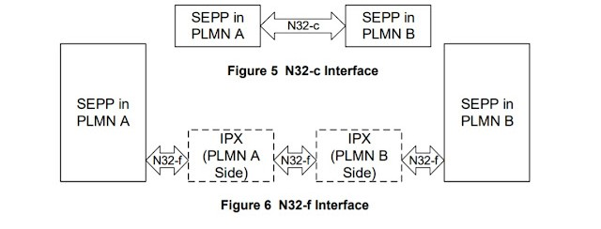
02. N32 Interface. How does SEPP work?
N32 – PLMN (Public Land Mobile Network) interconnection interface
N32-c – Control Panel Interface N32-f – Forwarding Interface IPX – Internetwork Packet Exchange
Slide no. 5

Slide 6
03. Functions. What does SEPP do?
MESSAGE FILTERING/PROTECTION
BORDER POLICING
TOPOLOGY HIDING
PREVENTION OF BIDDIN DOWN ATTACKS
Slide no. 6

Slide 7
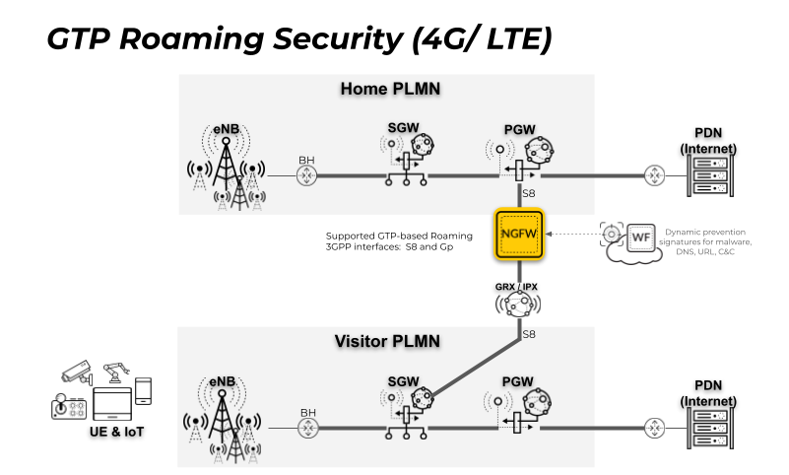
04. 4G SEPP? Does 4G use something similar?
NGFW – Next Generation Firewall GRX - GPRS roaming exchange GPRS - General Packet Radio Service
eNB – evolved NodeBs SGW - Cisco Serving Gateway PGW - Cisco Packet Data Network Gateway
PDN - Packet Data Network
Slide no. 7

Slide 8
Thanks!
Do you have any questions?

Slide 9
REFERENCES
Security in 5G Specifications - Controls in 3GPP : https://www.enisa.europa.eu/publications/security-in-5g-specifications
5G Roaming with SEPP : https://blog.3g4g.co.uk/2020/06/5g-roaming-with-sepp-security-edge.html Service Based Architecture (SBA) for 5G Core (5GC) :
https://blog.3g4g.co.uk/2018/02/tutorial-service-based-architecture-sba.html

